Slide 1
Nifty50 forecasting and trading strategies
Barbieri Claudio, Delera Giacomo, Huser Cyril, Howe Alessandro
Econometrics project 2024/2025
Lecturer: Azzone Michele
TA: Sala Edoardo

Slide 2

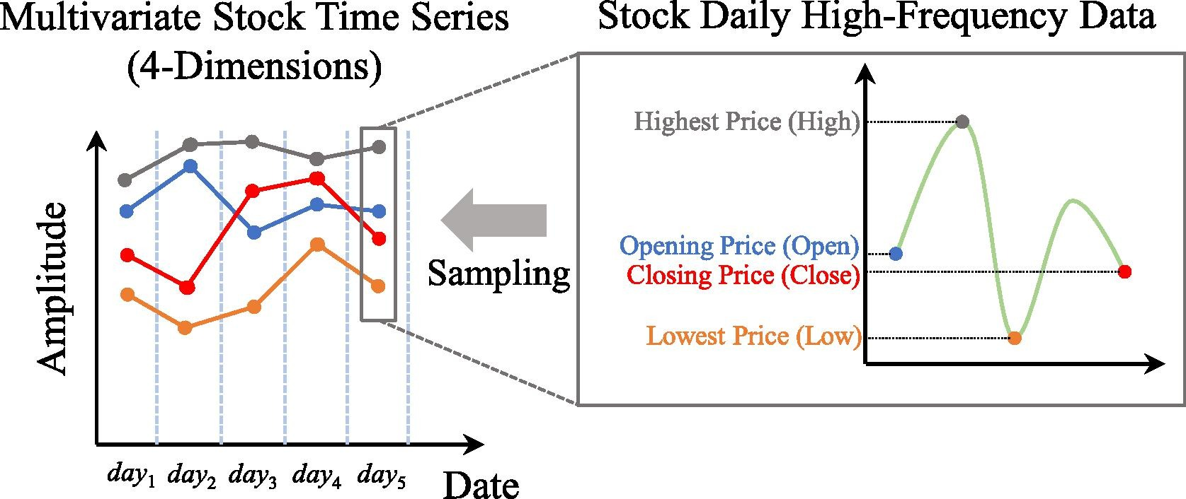
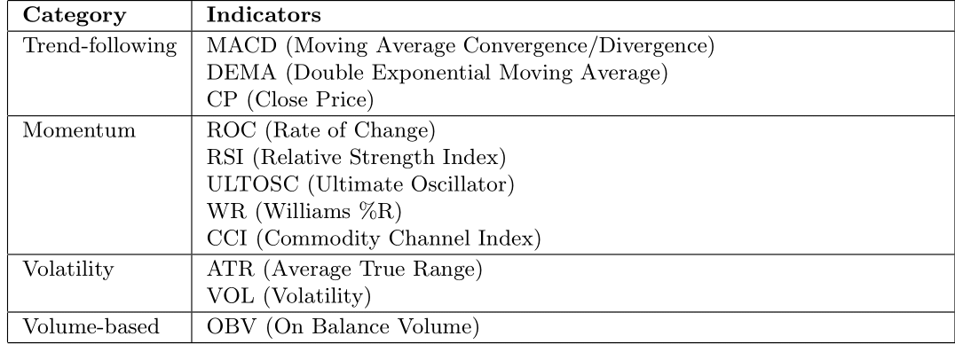
Data
Indexes
Stocks
High-frequency (minute-level) data of the Indian stock market from 2017 to 2021
Select Nifty50 index data from 2017,2018, and 2019 to avoid the COVID-19 pandemic
Aggregate into daily Open High Low Close prices to reduce noise level
Extract a proxy for the index Volume from the constituent underlying stocks
Compute some technical indicators to use as features

Slide 3
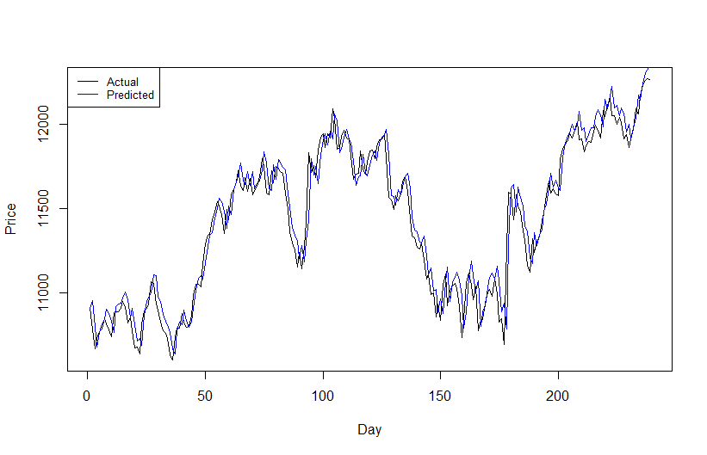


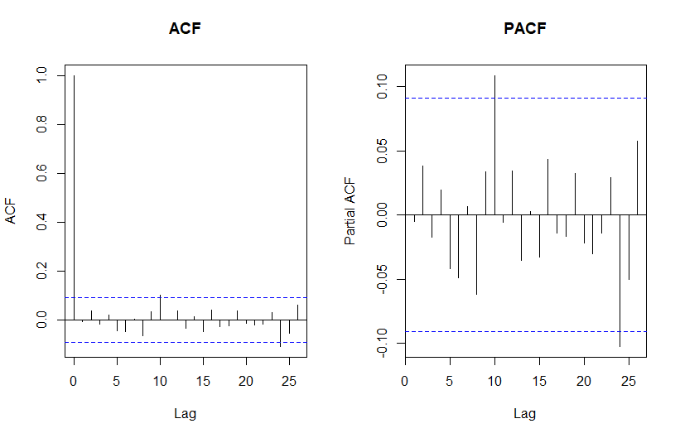
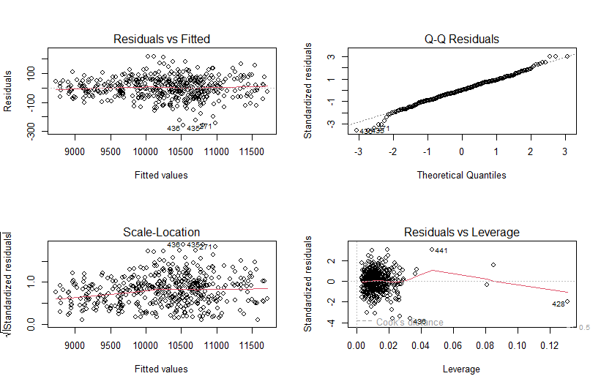

Linear Model
Predict the close price of Nifty50 using technical indicators
with a linear regression model
Variable selection: backward/forward minimizing AIC
Training set: 2017, 2018
Test set: 2019
No interest in the statistical reliability here,
just focus on the forecast power
Spurious high R² from non-stationary features
Heteroskedastic residuals
Non-normal error distribution
Diagnostics for guiding future modeling
No autocorrelation detected after including lagged values

Slide 4
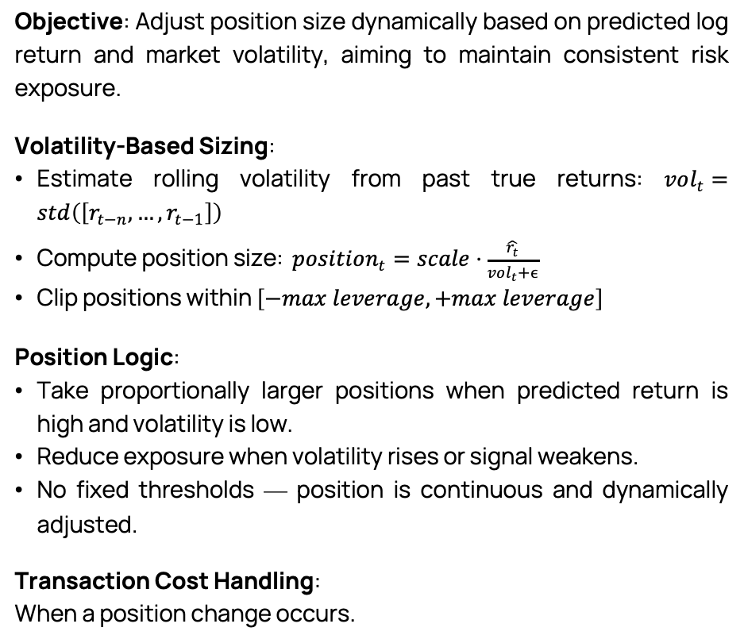
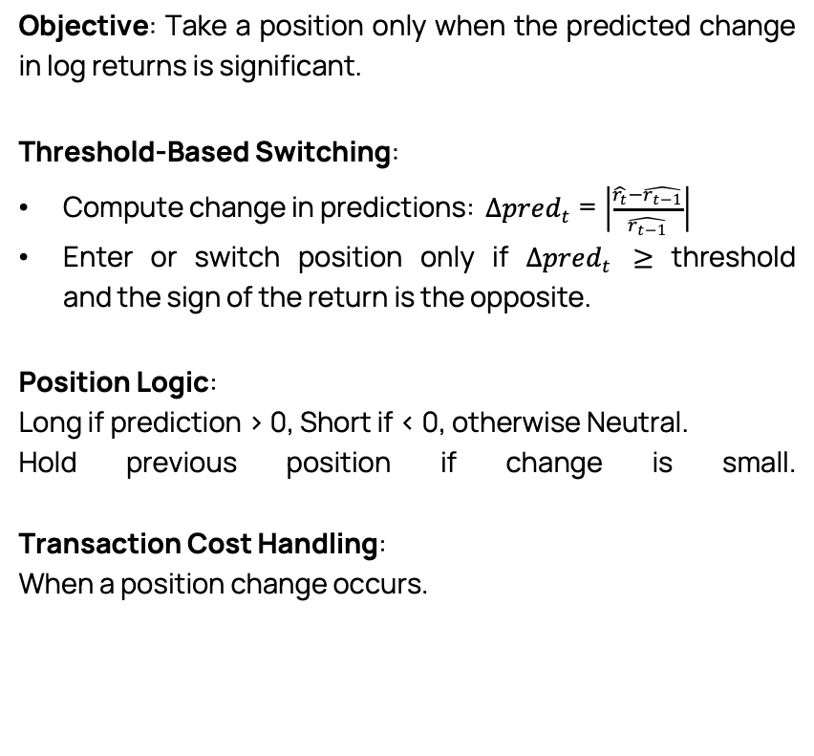
Absolute Change Threshold Strategy
Trading strategies
Volatility-Scaled Strategy
Objective: Take a position only when the predicted change in log returns is significant.
Threshold-Based Switching:
Compute change in predictions: $Δpred_{t}$= $\left|\frac{\hat{r_{t}}−\hat{r_{t−1}}}{\hat{r_{t−1}}}\right|$
Enter or switch position only if $Δpred_{t}$ ≥ threshold and the sign of the return is the opposite.
Position Logic:
Long if prediction > 0, Short if < 0, otherwise Neutral.
Hold previous position if change is small.
Transaction Cost Handling:
When a position change occurs.
Objective: Adjust position size dynamically based on predicted log return and market volatility, aiming to maintain consistent risk exposure.
Volatility-Based Sizing:
Estimate rolling volatility from past true returns: $vol_{t}=std\left(\left[r_{t−n},…,r_{t−1}\right]\right)$
Compute position size: $position_{t}=scale⋅\frac{\hat{r_{t}}}{vol_{t}+ϵ}$
Clip positions within $\left[−max leverage,+max leverage\right]$
Position Logic:
Take proportionally larger positions when predicted return is high and volatility is low.
Reduce exposure when volatility rises or signal weakens.
No fixed thresholds — position is continuous and dynamically adjusted.
Transaction Cost Handling:
When a position change occurs.

Slide 5
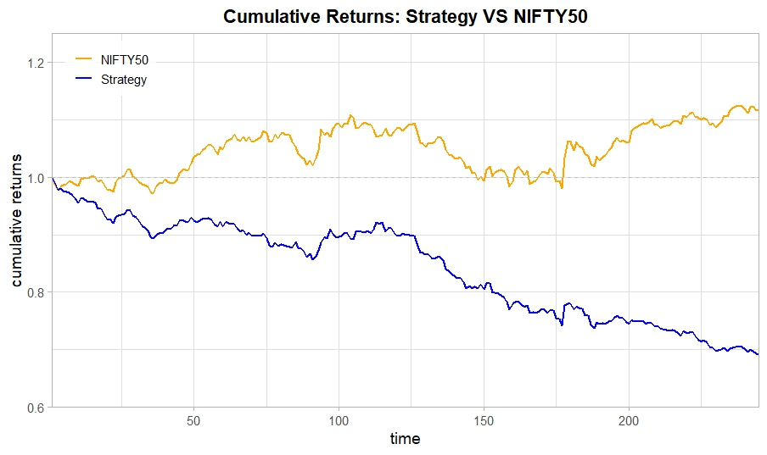
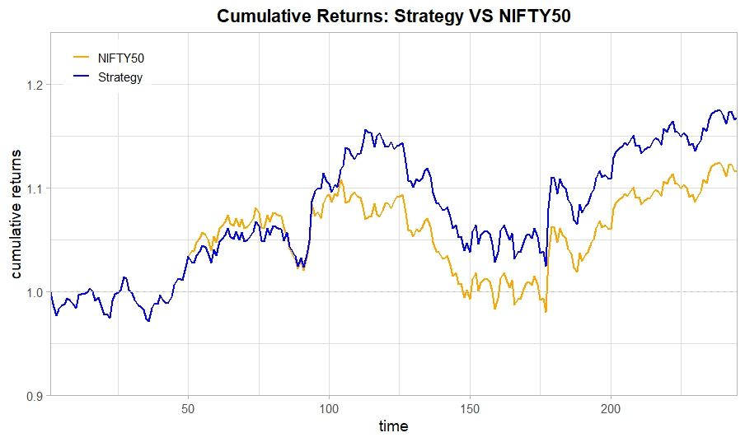
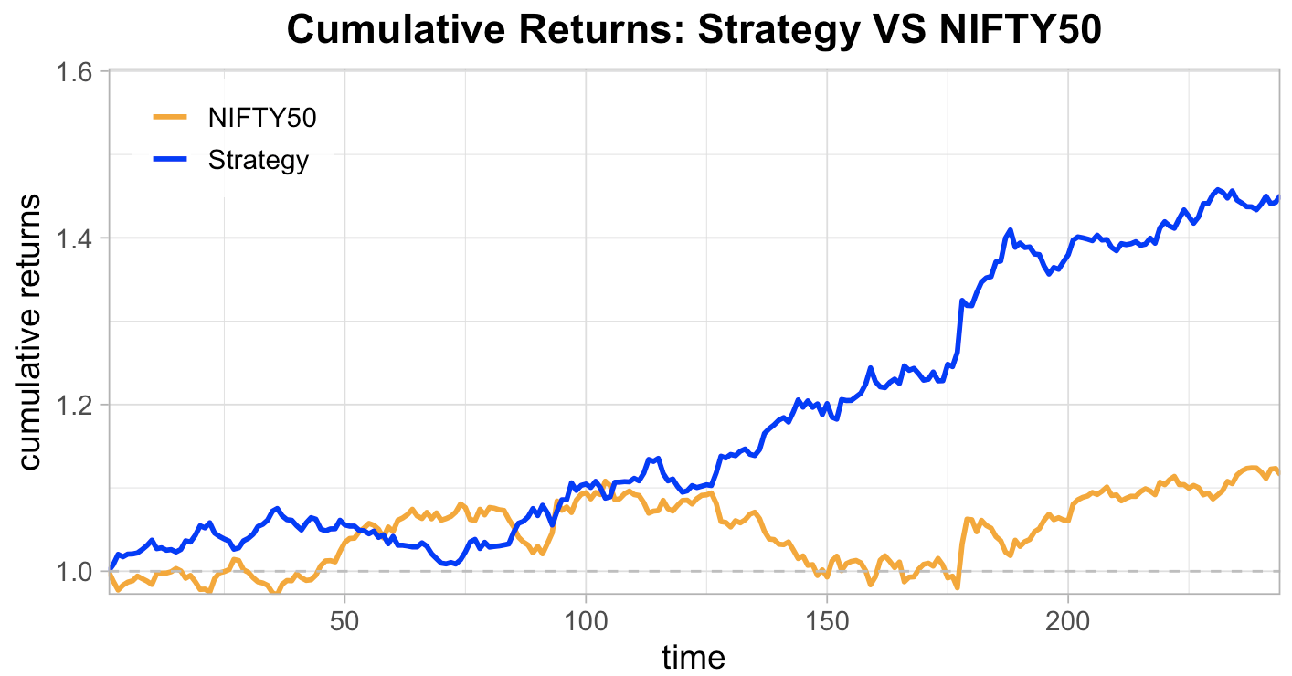
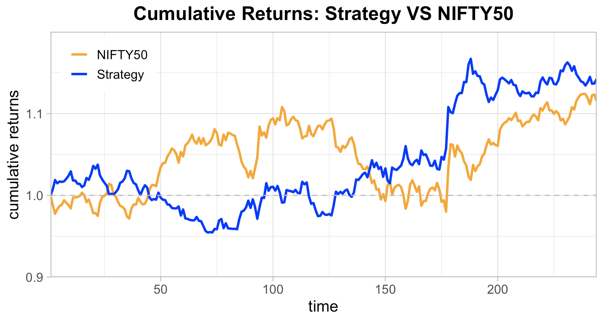
Our choice: Fixed Threshold Sign Strategy
Result on Linear Model:
Intraday trading Whole day trading
Objective: Daily trading strategy, taking long or short positions based on the predicted log return. While not the most advanced approach, it best allowed us to evaluate the index forecast — our primary objective.
Signal-Based Positioning:
Long if prediction > threshold, Short if < -threshold, Neutral otherwise.
2 Variants:
Log( Close / Previous Close ) measures the daily return, encompassing both overnight and intra-day price changes between two consecutive closes.
Log( Close / Open ) captures the intra-day return, reflecting the price movement from the market open to close within the same trading day.
.
Even if the 2nd is the “classical” definition of log return, strategies based on Log(Close/Open) often provide more consistent and reliable signals for short-term trading.
Transaction Cost Handling:
When a position change occurs.
Exiting and entering the market costs.
Annualized Return: -31.34%
Sharpe Ratio: -3.00
Max Drawdown: 30.79%
Sortino Ratio: -4.98
Annualized Return: 17.79%
Sharpe Ratio: 1.24
Max Drawdown: 11.38%
Sortino Ratio: 2.40
Remark: strategies with frequent trades suffer cost accumulation.
Zero transaction cost 5 bps transaction cost
Annualized Return: 44.22%
Sharpe Ratio: 3.13
Max Drawdown: 4.79%
Sortino Ratio: 6.33
Annualized Return: 14.73%
Sharpe Ratio: 1.21
Max Drawdown: 8.00%
Sortino Ratio: 2.28
Transaction costs

Slide 6
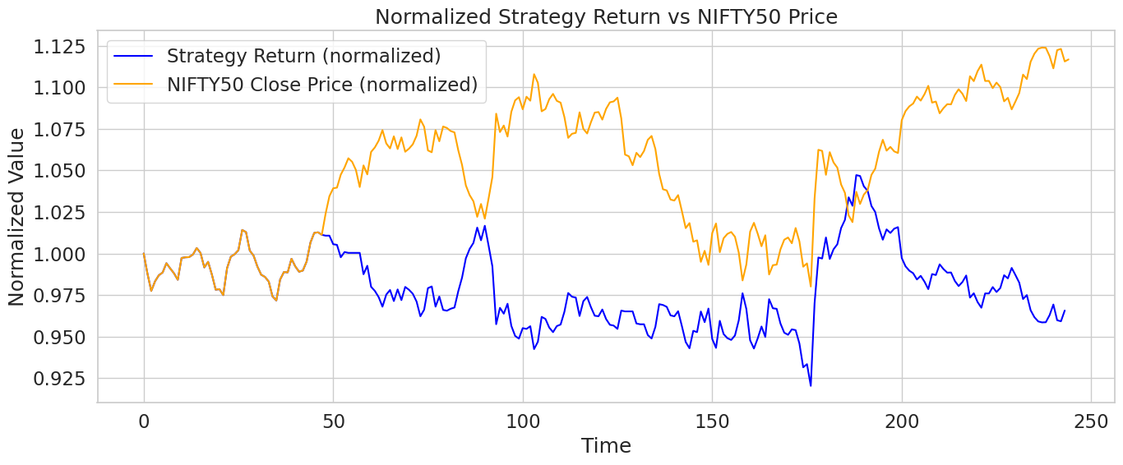
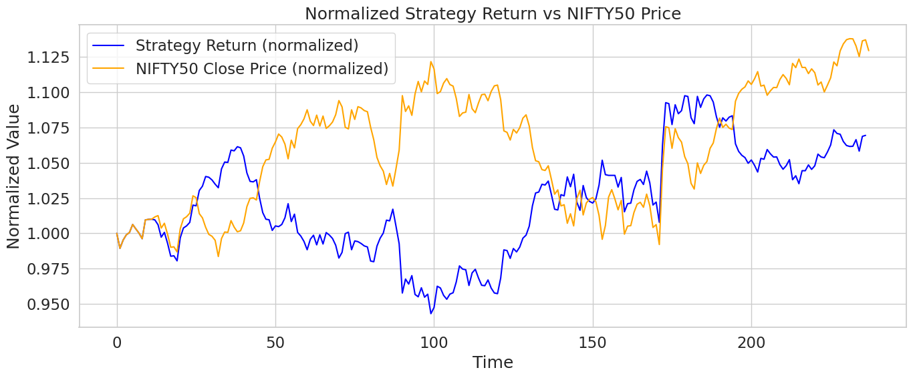
(Conv-)LSTM
Whole-day trading
Leverage LSTM’s sequence “memory” plus local feature extraction via 1D convolutions, common in financial forecasting literature
Input tensor: N x W x F
N: total samples (sliding windows)
W: window size (days of history)
F: features per day
Annualized Return: -3.12% Max Drawdown: 9.49%
Sharpe Ratio: -0.16 Sortino Ratio: -0.28
Sliding-window encoding
stride 1 (one-day step)
many-to-one (single output)
Feature scaling: Min-Max scaling
Option 1: NIFTY50 (prior‑day log‑return + prior-day volume + technical indicators)
Option 2: NIFTY50 + SP500 (prior‑day NIFTY50 and SP500 log-return + prior-day NIFTY50 and SP500 volume + NIFTY50 technical indicators
Annualized Return: 5.95% Max Drawdown: 11.13%
Sharpe Ratio: 0.49 Sortino Ratio: 0.78

Slide 7

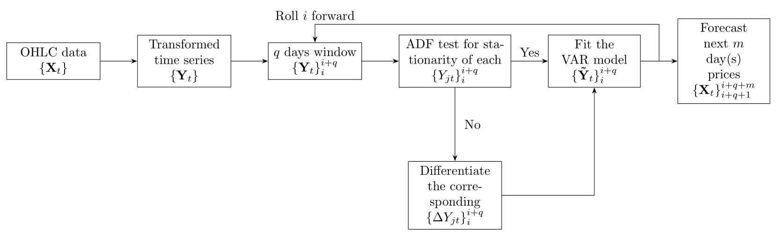
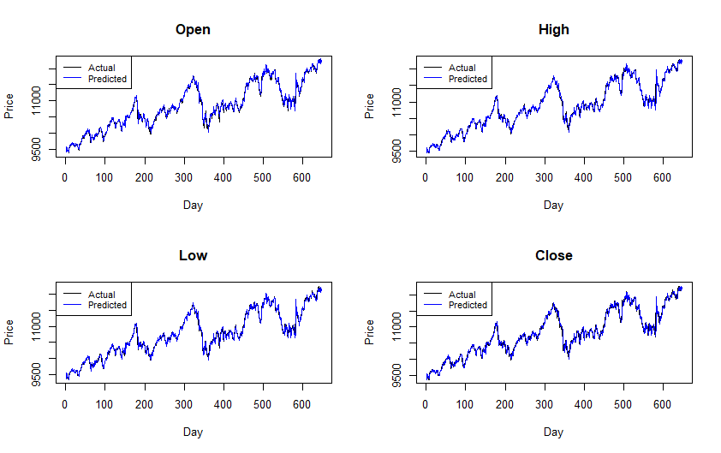

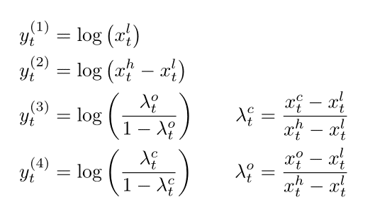

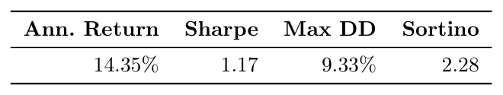
VAR on OHLC
Enable mutual influence among OHLC variables via dynamic multivariate model: VAR
Transformation to ensure constraints satisfaction
Best result on intraday with fixed threshold strategy

Slide 8
GARCH
Ilustration
New modeling paradigm

Slide 9
Probabilistic trading strategy
New trading strategy
Performance

Slide 10

Conclusion
Wrapping up:
Linear model using technical indicators offers good prediction for whole-day trading
LSTM with log return cannot generate profit with the used strategy
VAR on the OHLC exhibits strong performance when targeting intraday returns
GARCH leverages probabilistic strategies to achieve positive results

Slide 11
References
[1] Zahra Fathali, Zahra Kodia Aouina, and Lamjed Ben Said. “Stock Market Prediction of NIFTY 50 Index Applying Machine Learning Techniques”. In: Applied Artificial Intelligence 36 (2022). doi: 10. 1080/08839514.2022.2111134. url: https://www.researchgate.net/publication/363632317_ Stock_Market_Prediction_of_NIFTY_50_Index_Applying_Machine_Learning_Techniques.
[2] Gang Ji et al. “An adaptive feature selection schema using improved technical indicators for predicting stock price movements”. In: Expert Systems with Applications 200 (2022), p. 116941. issn: 0957- 4174. doi: https://doi.org/10.1016/j.eswa.2022.116941. url: https://www.sciencedirect. com/science/article/pii/S0957417422003712.
[3] Fatemeh Moodi, Amir Jahangard-Rafsanjani, and Sajad Zarifzadeh. Feature selection and regression methods for stock price prediction using technical indicators. 2023. arXiv: 2310.09903 [q-fin.ST]. url: https://arxiv.org/abs/2310.09903.
[4] Huiwen Wang, Wenyang Huang, and Shanshan Wang. Forecasting open-high-low-close data contained in candlestick chart. 2021. arXiv: 2104.00581 [econ.EM]. url: https://arxiv.org/abs/ 2104.00581.

Slide 12
Thank you for the attention!

